Slide 1
CAPSTONE PROJECT
THE BATTLE OF NEIGHBORHOODS

Slide 2
INTRODUCTION
People from all over the globe tend to migrate to the New York City to enjoy the metropolis benefits of the city. Among all those migrated, are sportspersons, athletes, gym rats and keep-fit-fanatics. Most of them while migrating seem to be confused about which part of the city they should settle. Their major preference is well accessible gyms or fitness centres. This project will explore the city of New York and try to solve this problem.

Slide 3
PROBLEM
This project will explore the data and find solutions as follows:
Visualize the city of New York on a map
Explore and visualize the boroughs and neighborhoods in the city
Explore Gyms and Fitness Centers in each borough
Explore Gyms and Fitness Centers in each neighborhood
Analyze the borough consisting the largest number of Gyms and Fitness Centers
Analyze the neighborhood consisting the largest number of Gyms and Fitness Centers
Select the preferred borough
Visualize the borough and its neighborhood on maps
Find possible solutions of settling in the best possible neighborhood

Slide 4
DATA SECTION
For this project we need the following data:
New York City Data from a website
Gyms and Fitness Centers in a neighborhood using Foursquare API
Geospatial Data using Geocoders

Slide 5
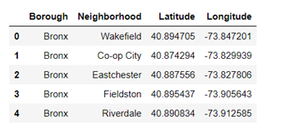
DATA PREPROCESSING
We download the JSON file from the website containing the New York City details, convert it to a Pandas dataframe, normalize it and drop the columns which are not required. The top five rows of the data frame looks like:

Slide 6
EXPLORATORY DATA ANALYSIS
Now that we have successfully cleaned our data and extracted the required features, we process to the following steps. We check the shape of our dataframe and find out that New York City has 5 boroughs and 306 neighborhoods. Using Geocode we can find the Latitude and Longitude of New York City by passing the address. Once we have found the Latitude and Longitude of New York City, we can plot a map of the city using Folium with markers having labels of Neighborhoods and Boroughs.

Slide 7
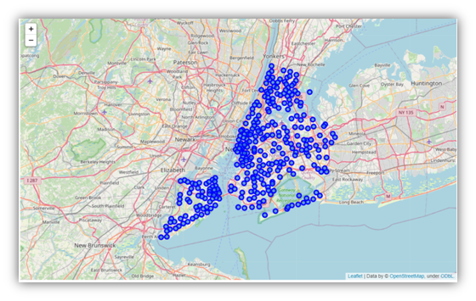
The plotted map looks like the following image:

Slide 8
Next, we define a function which takes in latitudes and longitudes of a place and return the names and IDs of all gyms and fitness centers within a specified radius of the place. With the help of the aforesaid function, we can find the names and IDs of all gyms and fitness centers within each neighborhood. The names and IDs are stored in a dataframe along with the Borough and Neighborhood. We can plot the number of Gyms and Fitness Centres for each Borough in New York City on a Bar Graph with the help of matplotlib.

Slide 9
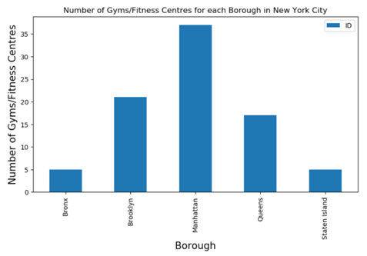
The plot looks like the following image:

Slide 10
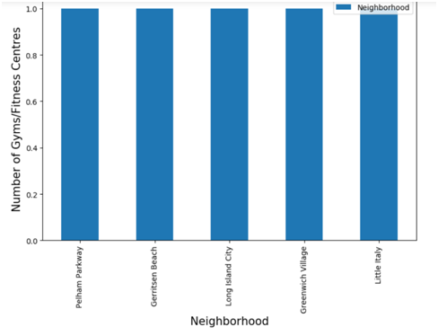
On visualizing the previous Bar Graph, we can clearly say that Manhattan has the highest number of Gyms and Fitness Centers.
We can also plot the number of Gyms/Fitness Centres for each Neighborhood in New York City:

Slide 11
From the above graph, we find that the top 5 neighborhoods have similar frequency and it is difficult for us to conclude which has the highest number. Thus, we analyze the neighborhoods of Manhattan and find out that all the neighborhoods have 1 gym or fitness center each.
We will now plot all the neighborhoods of the borough of Manhattan which has one Gym or Fitness Center on a map of New York using Folium.

Slide 12

The image of the map is shown below:

Slide 13
We can further use Foursquare API to find the rating of the all the Gyms and Fitness Centers in Manhattan. We can form a dataframe and analyze it. After visualization, we can select the few top rated Gyms and Fitness Centers. Then, we can suggest settlements in the nearby neighborhoods of the top rated Gyms and Fitness Centers.

Slide 14
CONCLUSION
I have successfully analyzed the data of various Gyms and Fitness Centers all across New York throughout this project based on the Boroughs and Neighborhoods they are located in. After analyzing and visualizing the data, I have come up with the conclusion that the borough of Manhattan has the highest number of Gyms and Fitness Centers in the city of New York. The data is also split up based on the neighborhoods of Manhattan. The Manhattan neighborhoods containing Gyms and Fitness Centers are plotted on a map of New York for visualization. This project can be further improved by collecting the ratings and tips of the Gyms and Fitness Centers and cluster the top rated ones. By doing so, we can filter the best neighborhoods for the settlements of athletes, sportspersons and gym rats. On an overview, I can conclude that this project serves as a solution for those who are looking to settle in neighborhoods in the New York City with good facilities of Gyms and Fitness Centers.

Slide 15
THANK YOU 🙂

